Slide 2
Celebrating Our History, Our Life, Our Future
A Timeline of Significant Moments

Slide 3
Before 1974
As early as the 1960’s, our members were active in parishes and dioceses from the Midwest to the California coast running prayer meetings, attending national and regional conferences and a variety of other works. Those stories will be told at another time.

Slide 4
However, in 1973
The folks in San Diego host the very first
Western Regional Conference
which became an annual event.
These conferences were instrumental in bringing people from San Diego, Los Angeles, northern California and Arizona together to serve the Lord.

Slide 5
September 1974
People of Joy is Founded
Founding members still with us:
Jim Donohue
Bill Eberhardt
Gayle Gibson
Jerry Johnson
Carole Johnson
Jim Jones
Carol Jones
Ed LeBeau
Carolyn LeBeau
Mary Lou Kockelman
Helen Peterson Gasca

Slide 6
1976
City of the Angels has its first Covenant Celebration.
The founding members of COTA are:
Steve Croskey
Melanie Croskey
Tim Dawson
Tom Lulling
Gabe Meyer
David Podegracz
Diane Podegracz
Dan Sauer
Marion Sauer

Slide 7
1977
Living Waters Community starts meeting
at the Balich home in San Diego

Slide 8
1978
Cluster begins in Tempe
“I will assemble My people
at the foot of Mount Carmel.”

Slide 9
June 1978
The Community Center is purchased.
Bishop James Rausch blesses it.
The weekend work parties begin.

Slide 10
February 1980
One Big Stream
The first joint conference of People of Joy
and City of the Angels coincides with
a 100 year flood of the Salt River Valley nearly cutting Phoenix and Scottsdale off from Tempe.

Slide 11
1981
The Resurrection Community from Aptos merged with the People of Hesed
from Carmel Valley and Salinas.
The new community is named
the People of God’s Word
Dean and Jossie Diaz
Denny and Susie Kehoe
Denny and Jean Powell
After much discernment, this community disbanded in 1985

Slide 12
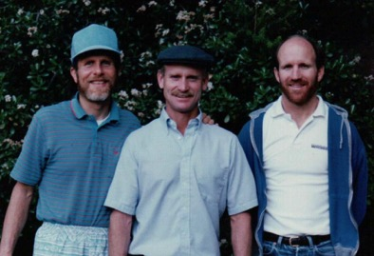
1982
2nd Joint Conference of People of Joy
and City of the Angels.
Making Phoenix younger and hipper!

Slide 13
Winter 1983
1st Christians in Commerce weekend held in Minnesota
2nd weekend held in Arizona a few months later
After 30 years:
22,000 people have attended Challenge Weekend
39 Chapters hold weekly meetings
In Uganda:
23 Challenge Weekends per year
24 Marriage Weekends per year

Slide 14
1983
Coordinators from COTA and POJ
meet to work out details
of becoming one community.

Slide 15
July 1983
Decision is made to adopt the name
City of the Lord
Isaiah 60:14
“ And you shall be called City of the Lord,
the Zion of the Holy One of Israel.”

Slide 16
September 1983
Living Waters Community begins to meet with
COTA in Van Nuys on a monthly basis.

Slide 17
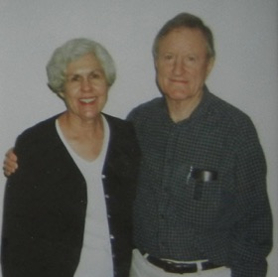
October 1983
It’s official!
One Community
One Covenant
One Body of Leaders
Ed LeBeau is chosen as the first Head Coordinator

Slide 18
February 1984
City of the Lord 1st Convocation
February 4th – the New COTL Covenant
is ratified at a solemn assembly.
All covenant members stand
to publicly commit themselves to the
Covenant of City of the Lord.

Slide 19
October 1985
The first members of the Jerusalem Colony mission work arrive in Jerusalem

Slide 20
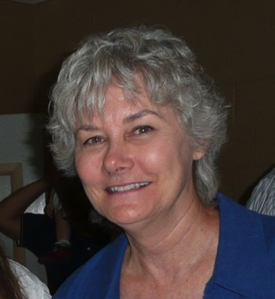
January 1985
Judith Freeman is hired by the Community
as the Director of our Memory Division:
Why we do what we do and
where we put it the last time we used it.

Slide 21
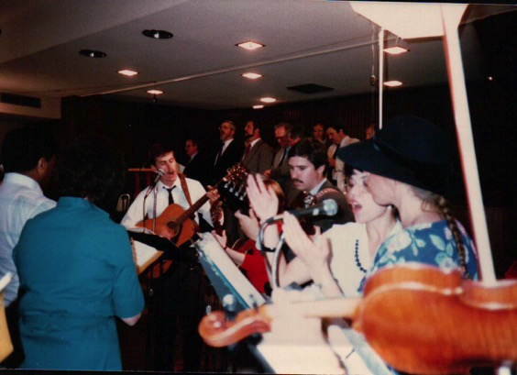
February 1985
Life in the City of the Lord
Our 2nd Convocation

Slide 22
1985
The Four Wells Prophecy is received in Jerusalem
I have placed four gifts in your life:
the gift of the Holy Spirit;
the gift of Worship;
the gift of Covenant Love;
the gift of Repentance.

Slide 23
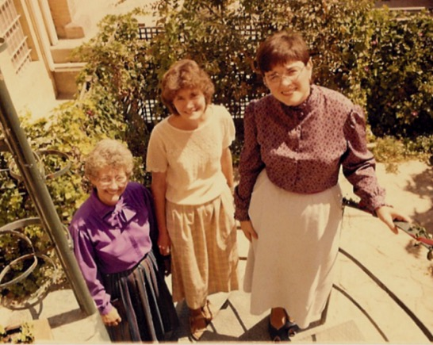
September 8, 1985
The Sisterhood is Founded In Jerusalem
“You are the Daughters of Jerusalem, the Daughters of the Cross…”

Slide 24
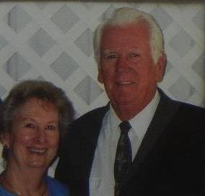
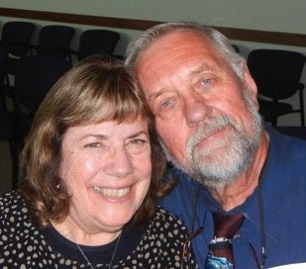
February 1986
Being City of the Lord
Our 3rd Convocation
Well of Worship is the focus
Welcome the San Diego Branch
Jerry and Claire Harvey
Mike and Margie Balich
make covenant

Slide 25
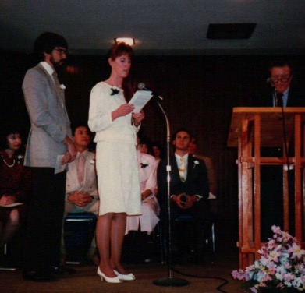
February 1987
A People in Transition
Our 4th Convocation
Well of the Holy Spirit is our focus

Slide 26
October 1987
Pope John Paul II opens the Synod on the Laity
John Mooney and Louis Grams give testimony

Slide 27
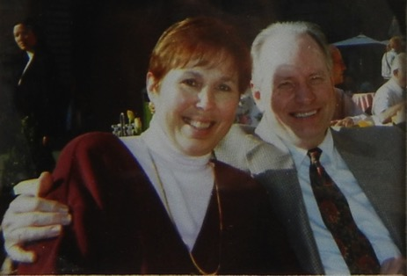
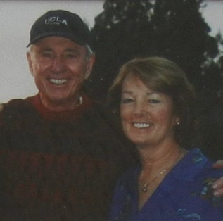
February 1988
Celebrating Our Life Together
Our 5th Convocation
Well of Covenant Love is the focus
Welcome the Monterey Branch
Bishop Albert de Monleon attends

Slide 28
1988
The new city of the Lord members from
the new Monterey Branch are:
Dean and Jossie Diaz
Martha Paradise
Dennis and Susie Kehoe
Dennis and Jean Powell
Gerrie Ridgway
Tom and Pina Sullivan
Liz and Tony Fernandez
George and Vickie Ivancovich
Maxine Malini

Slide 29
February 2, 1988
Gayle, Maxine and Pat make their commitment to the Sisterhood

Slide 30
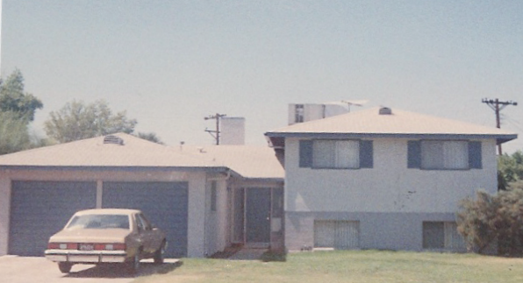
June 1988
Sisterhood home is purchased in the neighborhood

Slide 31
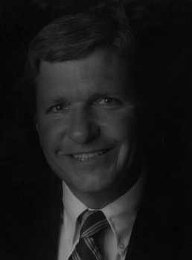
September 1988
The Community governance is changed to create the Community Council with an Overall Coordinator, four Principal Branch Coordinators and two Advisors
John Mooney is selected as the first Overall Coordinator

Slide 32
February 1989
Come Away With Me for I Am a Merciful God
1st time children attend
415 adults, 112 children, 18 of them are infants
Dennis and Harriet McBride from Alleluia attend

Slide 33
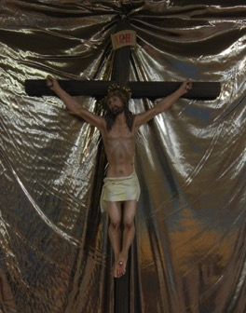
February 1990
Building City of the Lord
1st Covenant Assembly – covenanted members only
The invitation to join the
Catholic Fraternity is announced
Prophecy: Bring the Cross to the Center

Slide 34
June 1990
Someone, it might have been Denny Powell, said,
“Hey gang...let’s do a summer camp for the kids. It’ll be great!”

Slide 35
November 1990
City of the Lord becomes a founding member of the
Catholic Fraternity of Charismatic Covenant
Communities and Fellowships

Slide 36
May 1991
Power for Our Life Now
1st Pentecost Convocation

Slide 37
June 1991
Jim and Denise are starting to figure out that they are in charge of summer camp

Slide 38
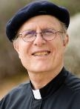
June 1991
Father Charlie Goraieb is ordained for
the Diocese of Phoenix becoming
the first priest from City of the Lord

Slide 39
Pentecost 1992
Mike and Patsy Gonzalez build and present
the first altar to the Community Center.
Later they presented the altar to Living Water and then an altar to the Cenacle.
Six bishops and innumerable priests have celebrated Mass on our altars.
Bishop Thomas O’Brien
Bishop Thomas Olmsted
Bishop Eduardo Nevares
Bishop Paul Cordes
Bishop Stanislaus Rylko
Bishop Albert deMonleon

Slide 40
June 1992
Summer camp becomes Camp Powell
Jim and Denise are starting to figure that
this will be a life long labor of love.

Slide 41
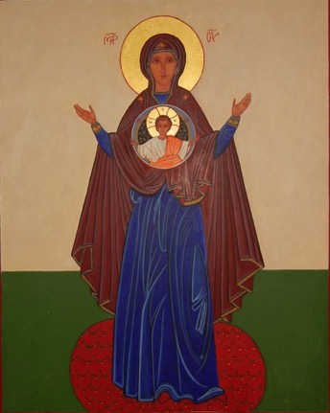
May 1993
Jesus is Lord – Source of Our Hope
2nd Pentecost Convocation
Installation of the Icon of Mary – Our Lady of Signs

Slide 42
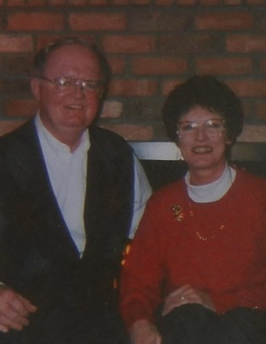
May 1994
Celebrating 10 Years of Covenant Life
2nd Covenant Assembly
Jim Jones is installed as new Overall Coordinator

Slide 43
May 1995
Living Together in a Covenant Community
1st Underway Convocation
Only underway members
and guests were invited

Slide 44
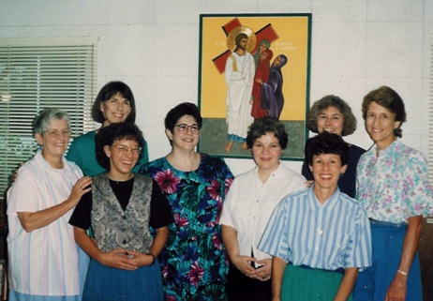
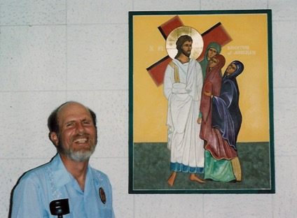
September 1995
Blessing of the Daughters of Zion icon

Slide 45
November 1995
1st Community Founders Forum

Slide 46
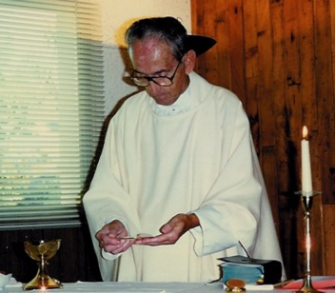
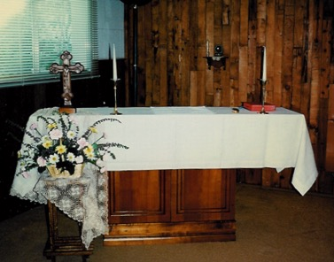
1996
Blessed Sacrament Installed in Sisterhood Chapel
Father Daniel McCready

Slide 47
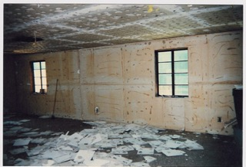
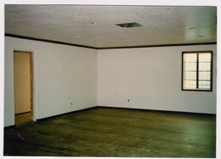
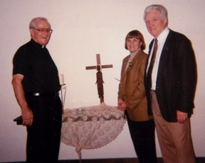
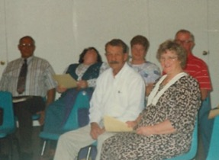
1996
Founding of the Cenacle of the Holy Spirit in the Community Center

Slide 48
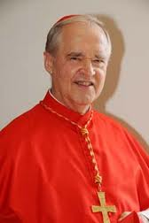
February 1996
The Great Jubilee
1st North American Catholic Fraternity Conference
Archbishop Paul Cordes (now Cardinal Cordes) and members of all the Fraternity communities attend
Marks the beginning of our Countdown to Jubilee

Slide 49
1996
The Monterey Branch is split into two branches:
the Santa Cruz Branch and the Monterey Branch.
In 2001 they were unsplit.
Proving, therefore, you can unscramble eggs.

Slide 50
May 1996
Ed Wilmowski calls for a Community-wide teen retreat. A few years later we held the first Community-wide kids retreat.
These two annual events have brought our children and many of their friends into the Baptism of the Holy Spirit.

Slide 51
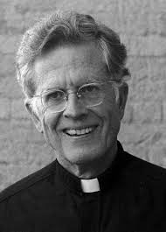
February 1997
Jesus Christ – Yesterday, Today and Forever
Our 9th Convocation
Youth to Youth Ministry from
Mount Zion Community ministers to us
Father Rick Thomas speaks

Slide 52
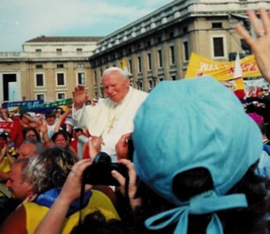
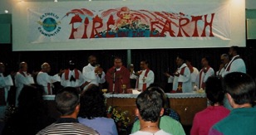
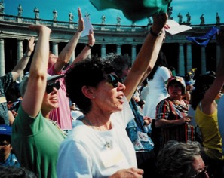
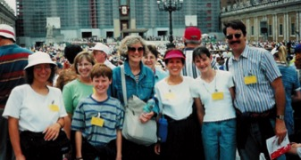
Pentecost 1998
Catholic Fraternity Conference in Rome in response
to the invitation of John Paul II for all of the
renewal movements and communities to celebrate with him.

Slide 53
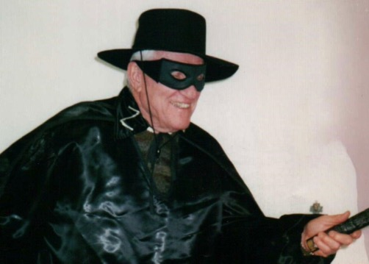
February 1999
Return to the Father
Our 10th Convocation
Guests from Mexican communities attend
Ed Wilmowski is installed as Overall Coordinator

Slide 54
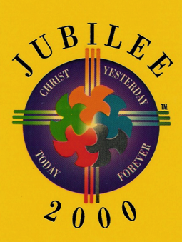
February 2000
City of the Lord Family Celebrates the Jubilee
Our 11th Convocation
Exhortation: If Ever There Was a Time – This is the Year
267 Adults and 222 children attend

Slide 55
February 2001
What It Means to Live a Life Together
3rd Covenant Celebration
Part of the Covenant review process
that was begun in June of 2000

Slide 56
Summer 2001
1st Youth Arise class moves in upstairs

Slide 57
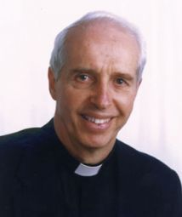
February 2002
Duc In Altum – Going Deeper Into Our Life Together
Our 12th Convocation
Father Francis Martin was the speaker
He blessed the Holy Family icon

Slide 58
October 2001
Leaders from COTL and Alleluia meet in Tempe
to recommit to the strong friendship
that exists between our two communities.

Slide 59
February 2003
Blow the Trumpet of Celebration
Our 13th Convocation
An encore from Father Francis Martin

Slide 60
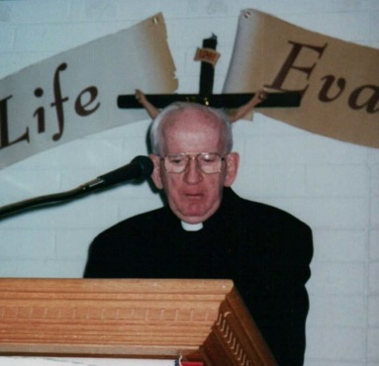
February 2004
20th Anniversary – A Year of Favor
Our 14th Convocation
Father Tom Forrest was the celebrant and speaker
Real Life Evangelization

Slide 61
Summer 2004
The Council creates the Mission Branch for Youth Arise grads and
Young Adults children of Community families
and their friends.
This branch was dissolved in 2008

Slide 62
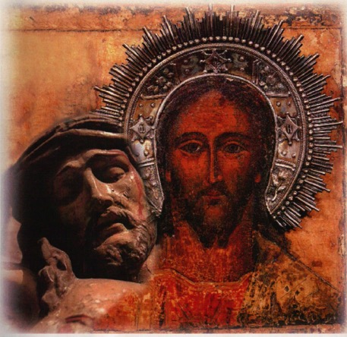
February 2005
Behold His Face In the Power of the Holy Spirit
Year of the Eucharist – 14 new Covenanted Members

Slide 63
April 2005
The First Tsunami Prophecy
A new wave of the Holy Spirit is upon us in this springtime of the new millennium.
In this wave of the Holy Spirit, two things are happening, a renewal and revitalization of all the gifts and graces of our Baptism, and a stripping away of all that clings to us that limits or impedes our walk in the Spirit.

Slide 64
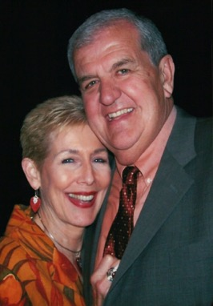
February 2006
All Things New In the Power of the Holy Spirit
Our 16th Convocation
Father Francis Martin and Father Andriy speak
Bob Carmody is installed as Overall Coordinator

Slide 65
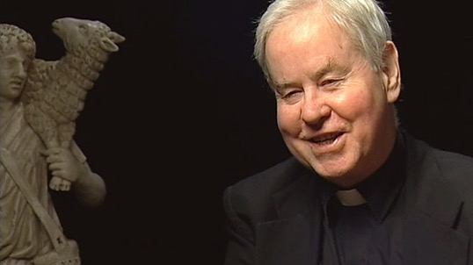
February 2007
Rejoice in the Hope of Jesus
Our 17th Convocation
Father Ian Kerr on the New Ecclesial Movements
Renovation of the Community Center has begun
Gathering Room and Dining Room completed

Slide 66
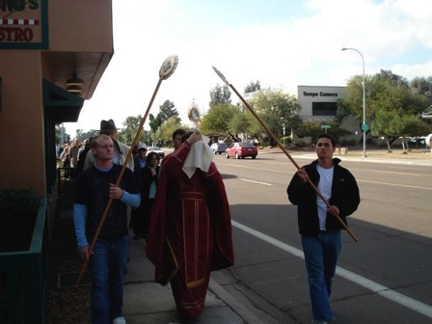
February 2008
Rejoice In the Hope of Sharing the Glory of God
Our 18th Convocation – Founding Charism
Eucharistic Procession down University Drive
Catholic Fraternity NA representatives attend
Receptivity to the Person and the culture of the Holy Spirit, particularly in covenant love.

Slide 67
February 2008
The Second Tsunami Prophecy
My people, I speak to you of a mighty wave of my Holy Spirit. I tell you that I call you my Friends, for I speak to you of my plans and all that is to be.
My Ardor breaks forth and will not be restrained.
Beg me for new gifts that I long to pour out upon you, new and more powerful than in the past.
Do not cling to the old; endure the emptiness so that I might make all things new within you.

Slide 68
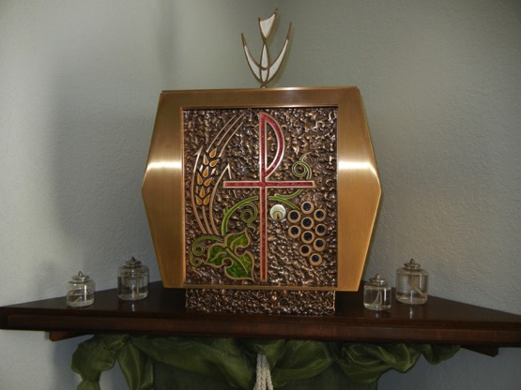
Summer 2008
Bishop Olmsted grants permission to reserve the Eucharist in the Cenacle of the Holy Spirit. Father Andriy triple blesses all of the religious articles in the Cenacle (just to be sure).

Slide 69
February 2009
Celebrating 25 Years of
Life Together In the Holy Spirit
Our 19th Convocation
Ardor – Audacity – Apostolic Life

Slide 70
February 2010
The Culture of the Holy Spirit
Our 20th Convocation
Kevin and Karen Murrell are snowbound in Augusta
New Bathrooms!

Slide 71
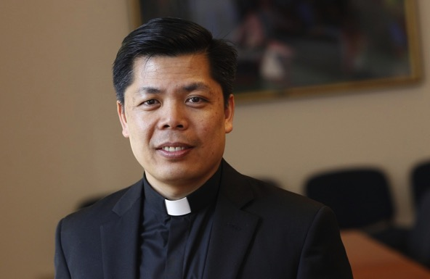
February 2011
Particularly in Covenant Love
Our 21st Convocation
Father Paul Bui of Cor Unum celebrates Mass

Slide 72
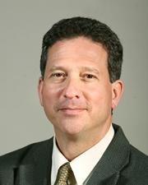
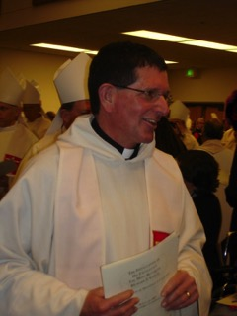
February 2012
Covenant Love from God’s Point of View
Our 22nd Convocation
Servant of the Word Dan Keating is the speaker
Father Patrick Dooling attends his 1st Convocation

Slide 73
June 2012
In His own response to the Root in the Well Prophecy, Jesus said to us
You have heard that your wells are weakened, blocked and polluted by the root of sin. So I say to you, “Come to ME and drink!” I am the pure source of the living water of the Holy Spirit, who enables you to repent and be healed. He will cut off the bitter root of sin among you. There is nothing to block you from drinking from Me

Slide 74
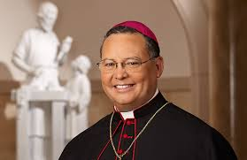
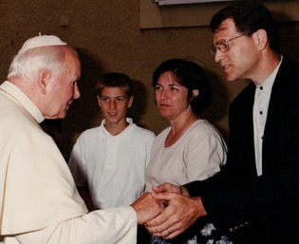
February 2013
Arise! Shine Out! Our 23rd Convocation
Bishop Eduardo Nevares celebrates Mass
New kitchen and offices for Bob, Peter and Judith
Peter is installed as Overall Coordinator
“Sing louder!”
Pope John Paul meeting Peter, Sharon and James

Slide 75
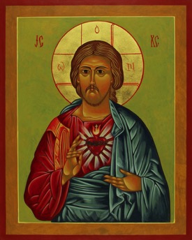
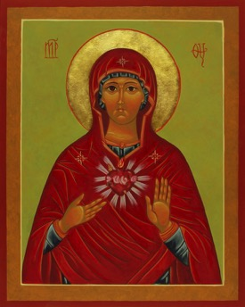
February 2013
Bishop Eduardo Nevares Enthrones the
Sacred Heart of Jesus and
the Immaculate Heart of Mary
in our Community Center

